Slide 1
Comprehensive Digital Marketing Project Work

Slide 2

Part 1: Brand study, Competitor Analysis & Buyer’s/Audience’s Persona
Company/Topic for project: MTR foods
Research Brand Identity: Study the brand's mission, values, vision, and unique selling propositions(USPs).
Brand colours
White, Red
LOGO :
Mission/Values:Enhance customers’ quality of life and anticipate their needs. Actively engage in communities we serve. Foster a company culture that staff can learn, grow and take pride in. Provide sustainable returns to investors.. We aim to be a globally recognised leader that connects and grows communities with caring service. A new vision and mission that reaffirms our commitment to different stakeholders while guiding our corporation to reach greater heights as a globally recognised leader.
USP:Our research has shown that variety is a key hook for weekend breakfasts and with 16 different breakfast solutions, variety is MTR's USP. We took this thought forward and understood from consumers that variety combined with a relaxed weekend morning are perfect ingredients for the family to bond.

Slide 3
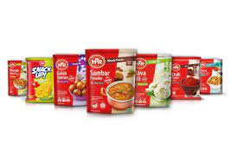
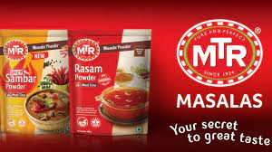
Part 1: Brand study, Competitor Analysis & Buyer’s/Audience’s Persona
Analyze Brand Messaging: Informative & Awareness
Examine the brand's tagline:MTR: Pure And Perfect.

Slide 4
Part 1: Brand study, Competitor Analysis & Buyer’s/Audience’s Persona
Competitor Analysis: Select three competitors operating in the same industry or niche as the chosen brand, examine their USPs and online communication.
Competitor 1: Patanjali Ayurved and Rage Coffee
https://www.patanjaliayurved.net
USP: the company says all its products are free of many unhealthy chemicals—including Monosodium Glutamate (MSG)—found in brands of many other FMCG majors.
ONLINE COMMUNICATION: through mails, calls and chat line
Competitor 2: Dabur
https://www.dabur.com
USP : We will continue to strategically focus on the 'herbal and natural' proposition as our core philosophy, both in India and abroad. In addition, the emphasis on health and wellness is our USP and makes Dabur a differentiated player in the consumer products market.
ONLINE COMMUNICATION : through chat box, video slats,
Competitor 3:PEPSI CO:
https://www.pepsico.com
USP :The company believes that winning with purpose translates to giving the best performance to execute your goal and purpose. Pepsi co believes that its past success is a mirror of its ambition, which has lead to the growth of the company.
ONLINE COMMUNICATION : through chat box, video slats and etc...

Slide 5
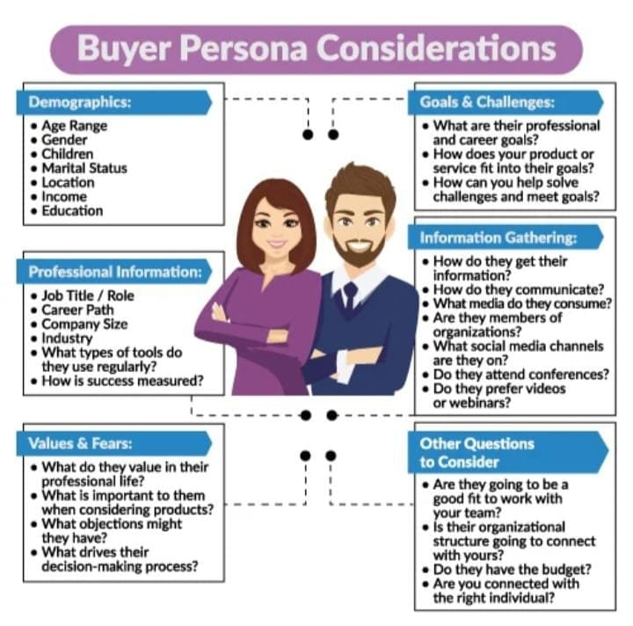
Part 1: Brand study, Competitor Analysis & Buyer’s/Audience’s Persona
Buyer's/Audience's Persona: Clearly define the target audience for the chosen brand. Consider demographics, psychographics, behaviors, and interests.
MTR foods:
Demographics
Age Range : above 18
Gender: All
Children: eligible
Location: all over India
Income: 500 crores
Education: 12th
Information Gathering:
How they get their information:
Community platforms, YouTube Ads, Facebook and Instagram ads.
Values/Fears:
Passion, Openness, Inclusiveness, Excellence, and Innovation / may be not satisfy the customers with their products, ownership, ethics.

Slide 6
Part 2: SEO & Keyword Research
SEO Audit: Do an SEO audit of the brands website
Keyword Research: Define Research Objectives, Brainstorm Seed Keywords, Utilize Keyword Research Tools (SEMrush or Moz Keyword Explorer),Analyze Competitor Keywords, Long-tail Keyword Exploration (specific, longer phrases) that align with the research objectives and have lower competition but higher conversion potential.
On page Optimization: Meta Tag optimization & content optimization
Reflect on the process of conducting keyword research and the SEO recommendations provided.
Document the challenges faced during the research and analysis phase, as well as the key insights gained from the keyword research process.

Slide 7
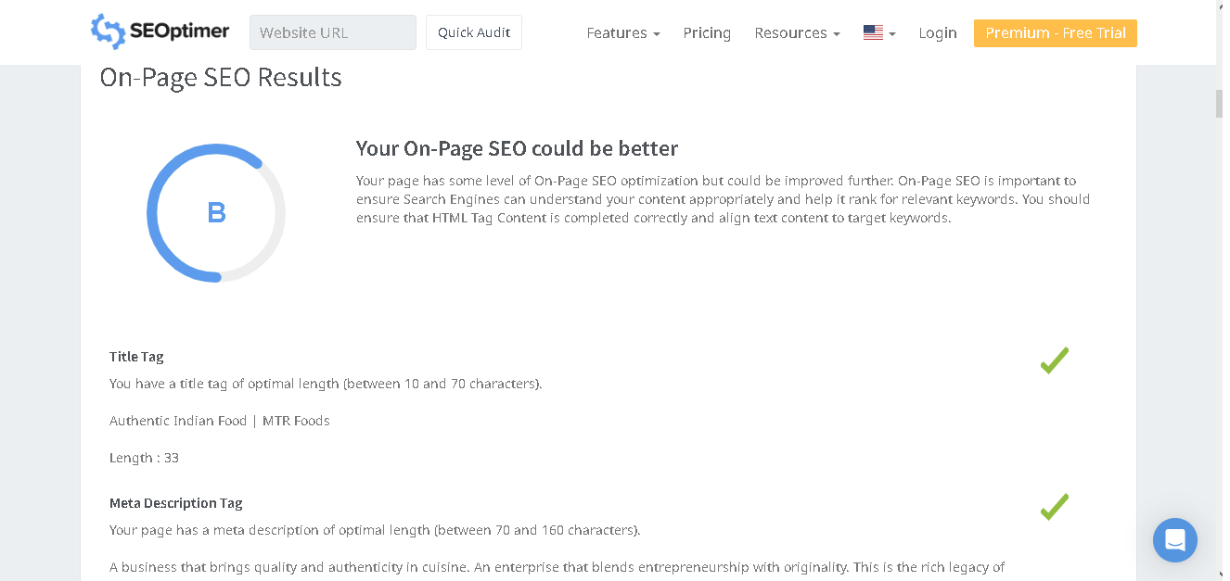
SEO Audit: Do an SEO audit of the brands website

Slide 8
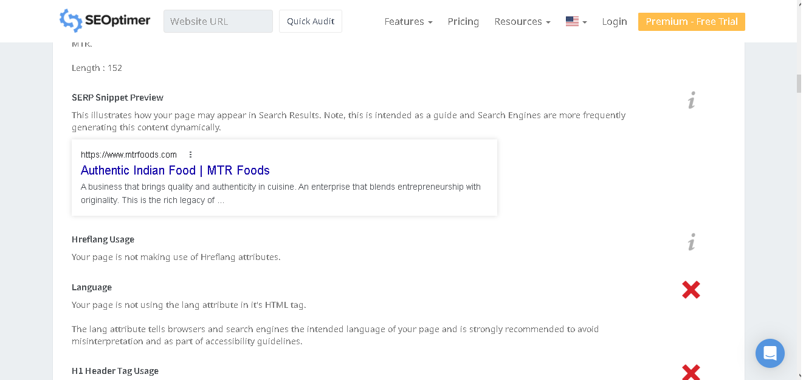

Slide 9
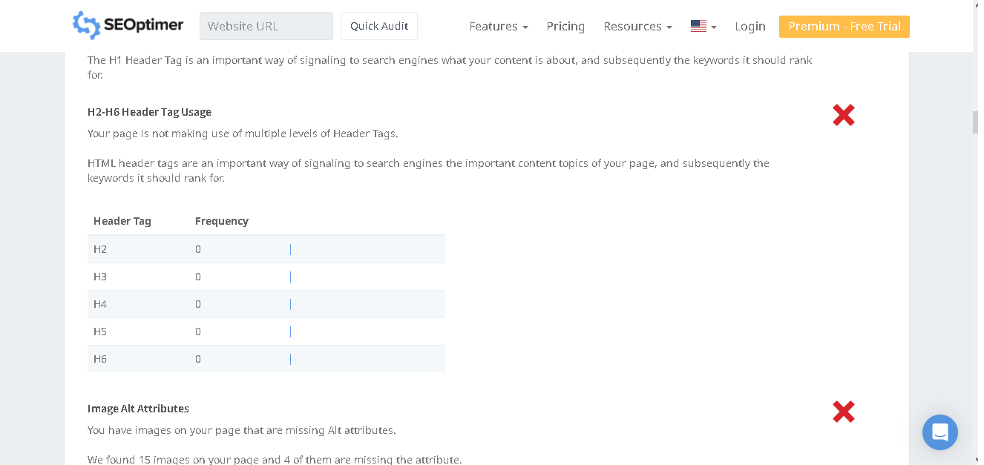

Slide 10
Keywords: Pickles
Keyword | Avg.monthly searches | competition
garlic pickle | 5000 | High
lemon pickle | 5000 | High
mixed pickles | 5000 | High
Meta Title
find the Tasty & Delicious garlic, lemon and mixed pickles |  |  | 58
Meta Description
buy new delicious & spicy pickles like garlic which natural and blended smoothly |  |  | 86
KEYWORDS: Noodles
Keyword | Avg.monthly searches | competition
instant noodles | 5000 | High
instant ramen | 5000 | High
ramen cup noodles | 5000 | High
Meta description
Buy the new tasty flavoured ramen noodles and it is made of pure it has different types |  |  | 95
meta title
Find the best noodles and ramens with unique taste |  |  | 51

Slide 11
KEYWORDS: Biryani Masala
Keyword | Avg.monthly searches | competition
hyderabadi biryani masala | 5000 | High
biryani masala | 50000 | High
biryani spices | 5000 | High
Meta title
MTR brands is always special in making masalas |  |  | 48
Meta description
MTR is always a brand mark for making masala mix in biryani essentials and they will do it in order . |  |  | 102
KEYWORDS: Gulab jamun
Keyword | Avg.monthly searches | competition
gulab jamun price | 5000 | High
gits gulab jamun | 5000 | High
mtr gulab jamun | 5000 | High
Meta title
every festival awesome and to add a little more with mtr gulab jamun |  |  | 69
Meta Description
MTR gulab jamun is one the famous dishes and also there are some safety precautions to follow to proceed to a great taste |  |  | 122

Slide 12
KEYWORDS: Poha
Keyword | Avg.monthly searches | competition
mtr instant poha | 500 | High
readymade poha | 500 | High
readymade poha | 50 | High
Meta title
Try poha feel awesome than before to maintain a healthy life |  |  | 60
Meta Description
buy poha and feel lighter to live healthy constant life and its made up of de huskled rice which makes a great breakfasts |  |  | 122

Slide 13
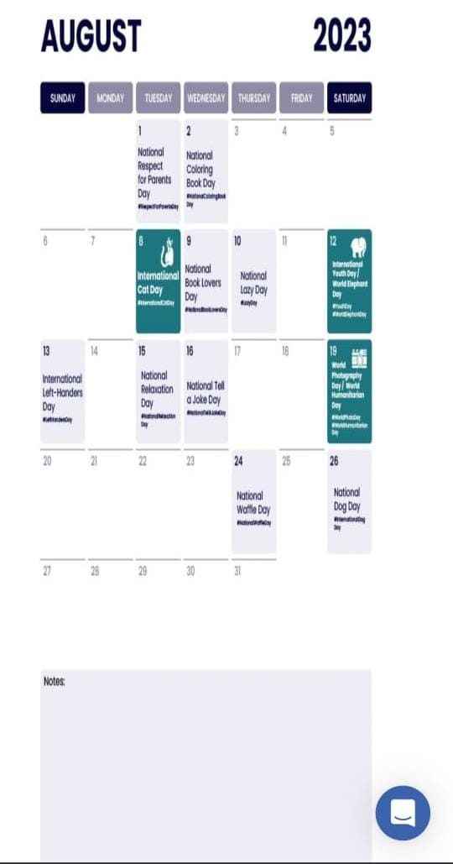
Part 3: Content Ideas and Marketing Strategies
Content Idea Generation & Strategy: Create a content calendar for the remaining month of July by brainstorming content themes, exploring various like Blog posts, videos, info graphics, podcasts, and interactive quizzes and scheduling publication dates mainly on Face book & Insta gram.
And include the strategy, aim and the idea behind these posts and story
Content calendar Example (Try creating a table for the month of July)

Slide 14
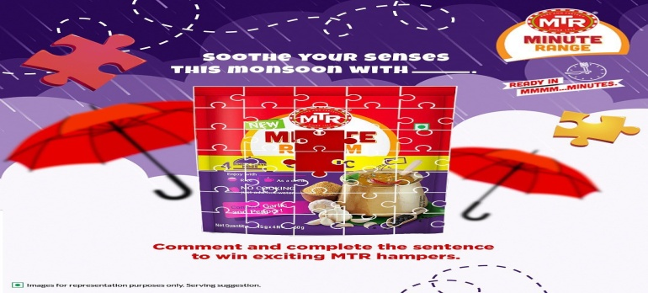
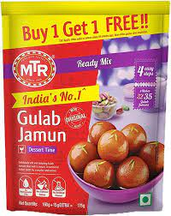
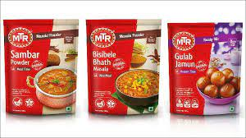
Part 3: Content Ideas and Marketing Strategies
Date: 3RD August 2023:
To excite customers mtr foods conducting puzzle contest in this monsoon season.
Using blog article
Date:4TH August 2023:
MTR Foods has introduced buy one get one offer. To made our festival day beautiful.
Date: 5THAugust 2023:
To excite customer MTR foods has given a special offer to all customer who are willing to buy will have special offer upto 50%.

Slide 15
Part 3: Content Ideas and Marketing Strategies
The process of developing content ideas and marketing strategies is critical for any business or brand to effectively reach its target audience, engage them, and ultimately achieve its goals. This process typically involves several key steps:
1. Market Research: Understanding the target audience, their needs, preferences, and pain points is fundamental to the content and marketing strategy development. Market research involves gathering data through surveys, interviews, competitor analysis, and social media monitoring to identify trends and opportunities.
2. Goal Setting: Clearly defining the objectives of the content and marketing efforts is essential. Whether it's increasing brand awareness, driving website traffic, generating leads, or boosting sales, specific and measurable goals guide the entire process.
3. Brainstorming and Ideation: Creative brainstorming sessions help generate a wide range of content ideas. These ideas can stem from industry trends, customer feedback, internal expertise, or a unique perspective on relevant topics.
4. Content Creation: Once the ideas are finalized, content creation begins. This can involve writing blog posts, producing videos, designing info graphics, creating social media posts, and more. Content should be valuable, informative, and aligned with the brand's voice and values.
5. Content Distribution: Deciding how and where to distribute the content is crucial. This could include leveraging social media platforms, email marketing, guest posting, influencer collaborations, SEO optimization, and paid advertising.
6. Performance Tracking: Measuring the effectiveness of the content and marketing efforts is vital for continuous improvement. Key performance indicators (KPIs) such as website traffic, conversion rates, engagement metrics, and ROI help assess the success of the strategies.
refine and optimize future content and marketing endeavours.

Slide 16
Challenges Encountered:
1. Audience Understanding: One of the significant challenges is truly understanding the target audience. It requires ongoing research and data analysis to stay up-to-date with evolving customer preferences.
2. Content Differentiation: Creating unique and valuable content in a crowded digital landscape is challenging. Ensuring that the content stands out and offers a fresh perspective can be difficult.
3. Content Consistency: Maintaining a consistent content schedule can be challenging, especially for small teams or businesses with limited resources.
4. Platform Diversity: Managing content across multiple platforms and tailoring it to suit each one's requirements can be time-consuming and resource-intensive.
5. ROI Measurement: Attribution and accurately measuring the ROI of content and marketing strategies can be complex, especially when various channels are involved.
Lessons Learned:
1. Audience-Centric Approach: Putting the audience at the center of all content and marketing decisions is crucial. Regularly interacting with customers, analyzing feedback, and staying updated with market trends helps create more relevant and valuable content.
2. Quality over Quantity: Rather than focusing on churning out a large volume of content, prioritizing quality is essential. Creating content that addresses specific pain points and delivers value is more effective in engaging the audience.
3. Diversification of Platforms: While managing multiple platforms can be challenging, diversifying the content distribution strategy allows reaching a broader audience and reduces dependency on a single channel.
4. Agile and Data-Driven Approach: Adopting an agile approach to content marketing allows for flexibility and quick adjustments based on data insights. Regularly tracking and analyzing performance data helps optimize strategies for better results.

Slide 17
Part 4: Content Creation and Curation (Post creations, Designs/Video Editing, Ad Campaigns over Social Media and Email Ideation and Creation)
Post Creation:
Select Content Categories: Identify three different content formats relevant to the chosen topic or industry. Research and Brainstorm: Research trending topics, industry news, or audience interests within each category. Brainstorm ideas for social media posts that align with each category. Do note that 1 content format has to be video and additionally 3 stories/status are to be created.
Format 1 : Blog article
Format 2: Video
Format 3:Creative

Slide 18
Part 4: Content Creation and Curation (Post creations, Designs/Video Editing, Ad Campaigns over Social Media and Email Ideation and Creation)
Format 1 : Blog article
Aim: Provide information about captain new products
Date:03/8/2023
Idea: Types of MTR food products
Topic :
A Steps-by-step Guide to MTR FOODS Types & Process
Step 1:Purchase MTR Foods products: Visit a supermarket or retail store that sells MTR Foods products. Choose from their assortment of ready-to-eat meals, spice mixes, snacks, or instant mixes. Some popular products include ready-to-eat meals like paneer butter masala, rajma masala, or pav bhaji, and instant mixes for idli, dosa, or upma.
Step 2:Read the instructions: Each MTR Foods product comes with clear instructions on the packaging. Carefully read the directions, cooking time, and any additional ingredients required for preparation.
Step 3:For Ready-to-Eat Meals: a. Tear open the pouch: Open the packaging of the ready-to-eat meal, usually a pouch or a tray. b. Heat the contents: Transfer the contents to a microwave-safe container or a pan, and heat it as per the instructions. In some cases, you may need to add water while heating. c. Serve and enjoy: Once heated, your ready-to-eat meal is ready to be served. You can enjoy it with rice, bread, or any accompaniment of your choice.

Slide 19
Step4 : For Spice Mixes: a. Gather the ingredients: Check the packaging for the list of additional ingredients needed. It may include vegetables, meat, or any other components. b. Prepare the dish: Follow the instructions on the package to mix the spice blend with the required ingredients. c. Cook the dish: Cook the mixture on a stovetop or in a pressure cooker, following the prescribed cooking time and method. d. Serve: Once cooked, your dish is ready to be served with rice, bread, or any other side dishes.
Step 5: For Instant Mixes:
a. Prepare the batter: Empty the contents of the instant mix into a bowl and add the specified amount of water or other liquid as per the instructions.
b. Mix thoroughly: Stir the mixture until you get a smooth batter. For some mixes, you may need to let the batter sit for a while to ferment (e.g., for idli and dosa).
c. Cook the dish: Pour the batter onto a hot tawa (griddle) for dosa or into idli molds for idlis. Cook until done.
d. Serve: Your freshly prepared dish is now ready to be served with chutney, sambar, or any other accompaniment.
Step 6: For Snacks:
a. Open the package: Unwrap the packaging to access the snack, whether it's a savory or sweet treat.
b. Enjoy: Simply eat and enjoy the snack as it is.
Always ensure that you follow the specific instructions provided on the MTR Foods product packaging for the best results. Additionally, be mindful of any allergens or dietary restrictions mentioned on the packaging.

Slide 20

Part 4: Content Creation and Curation (Post creations, Designs/Video Editing, Ad Campaigns over Social Media and Email Ideation and Creation)
Format 2: video
Aim: to promote different type of products
Date: 4th august 2023
Idea: MTR foods and its different types of products
Topic: In this video I visualised in a very brief manner about different types of products & its benefits

Slide 21
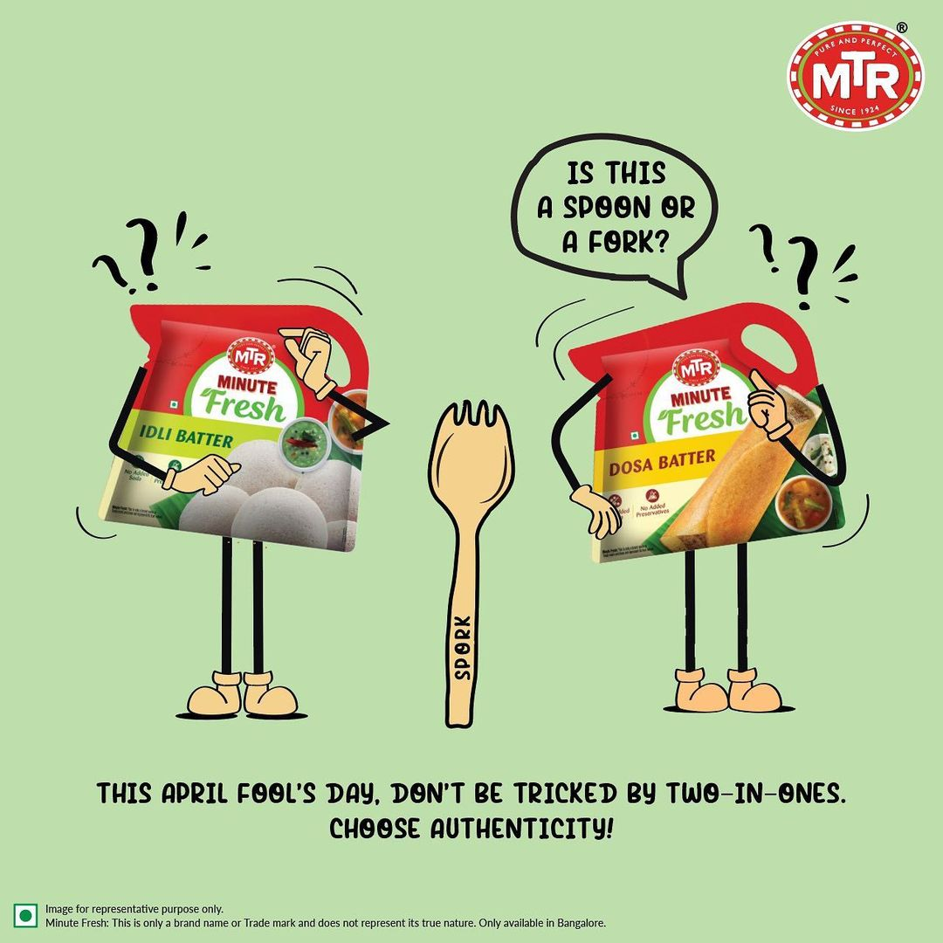
Part 4: Content Creation and Curation (Post creations, Designs/Video Editing, Ad Campaigns over Social Media and Email Ideation and Creation)
Format 3: Creative
Aim: Promote the content of idli and dosa batter.
Date: 5th august 2023
Idea: To create a meme about product of mtr foods.

Slide 22
Part 4: Content Creation and Curation (Post creations, Designs/Video Editing, Ad Campaigns over Social Media and Email Ideation and Creation)
Instagram Story
Utilize the stories feature on Instagram for three consecutive days. Share behind -the- scenes glimpses, polls,quizzes,
Or sneak peeks etc to encourage audience participation. Once uploaded use the story highlight feature on instagram
And save the 3 story with and appropriate with an name for each.
Note:
Once done monitor the performance of the posts and Stories using the insight tool and analyze the engagement
Metrics (likes, comments, shares, impressions, etc). Based on the analysis, mention the strategies and areas for
Improvement.

Slide 23
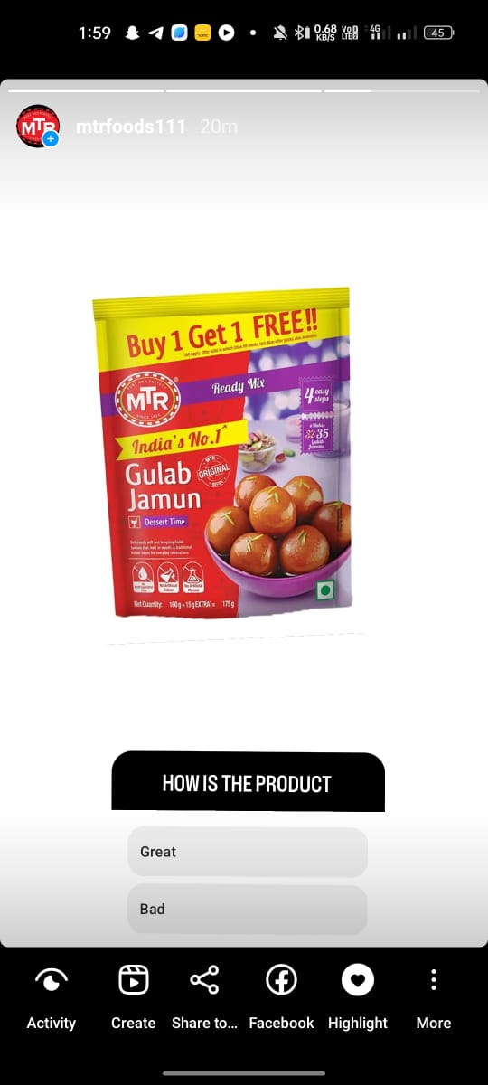
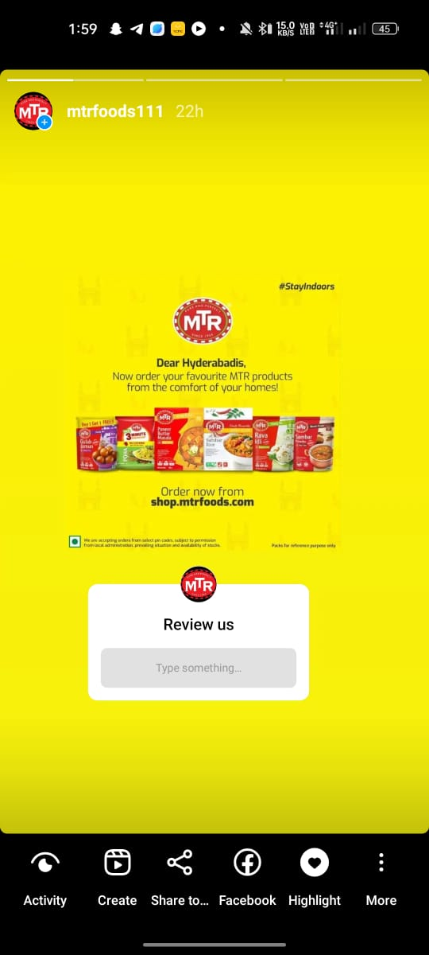
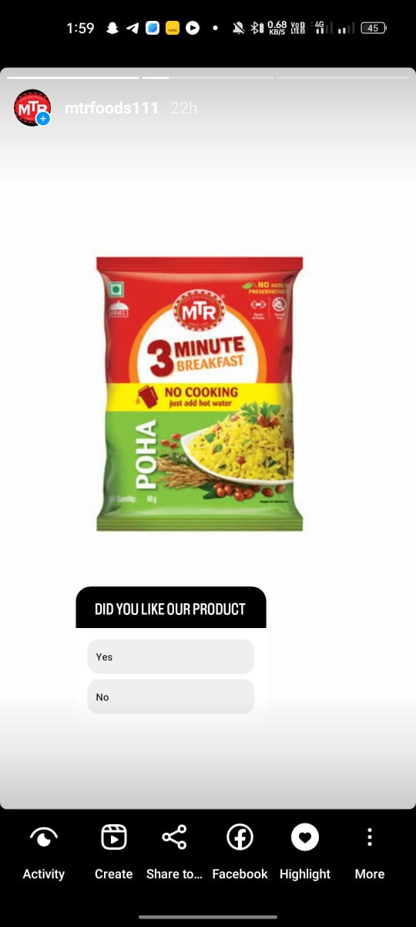
Part 4: Content Creation and Curation (Post creations, Designs/Video Editing, Ad Campaigns over Social Media and Email Ideation and Creation)
Instagram Story

Slide 24
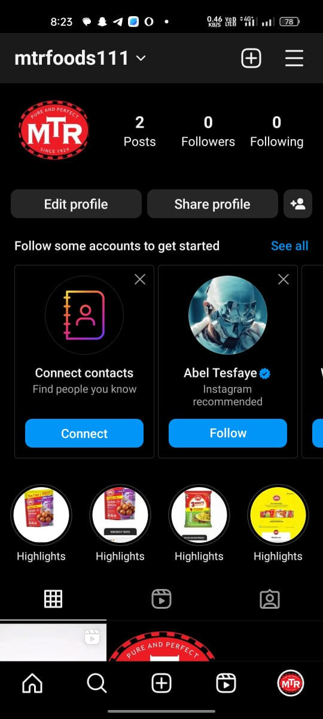

Slide 25
Part 4: Content Creation and Curation (Post creations, Designs/Video Editing, Ad Campaigns over Social Media and Email Ideation and Creation)
Designs/Video Editing
Design Tools Familiarization (use Canva for creating visually appealing graphics)
Video Creation: Utilize VN or any video editor of your choice to create videos related to the chosen topic.

Slide 26
Part 4: Content Creation and Curation (Post creations, Designs/Video Editing, Ad Campaigns over Social Media and Email Ideation and Creation)
Social Media Ad Campaigns
Ad Campaigns over Social Media:
Come up with 3 ad campaigns each covering one of the mentioned goals: brand awareness, driving website traffic, or generating leads

Slide 27
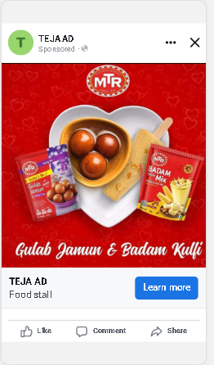
Part 4: Content Creation and Curation (Post creations, Designs/Video Editing, Ad Campaigns over Social Media and Email Ideation and Creation)
Social Media Ad Campaigns
BRAND AWARENESS:
Targeting: location all over india, all genders interest: dabur,haldiram’s,acchi,patanjali

Slide 28
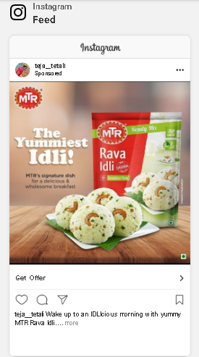
Part 4: Content Creation and Curation (Post creations, Designs/Video Editing, Ad Campaigns over Social Media and Email Ideation and Creation)
Social Media Ad Campaigns
DRIVING WEBSITE TRAFFIC:Targeting: location all over india, all genders interest: dabur,haldiram’s,acchi,patanjali

Slide 29
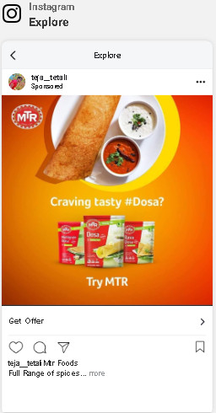
Part 4: Content Creation and Curation (Post creations, Designs/Video Editing, Ad Campaigns over Social Media and Email Ideation and Creation)
Social Media Ad Campaigns
LEAD GENERATION :Targeting: location all over india, all genders interest: dabur,haldiram’s,acchi,patanjali.

Slide 30
Part 4: Content Creation and Curation (Post creations, Designs/Video Editing, Ad Campaigns over Social Media and Email Ideation and Creation)
For every campaign clearly define:
Advertising Goals: increasing brand awareness, driving website traffic, or generating leads.
Audience Targeting: Define the target audience for the ad campaigns based on demographics, interests, and behavior.
Ad Creation: Create visually appealing ad creatives, compelling ad copy and relevant call-to-action.

Slide 31
Part 4: Content Creation and Curation (Post creations, Designs/Video Editing, Ad Campaigns over Social Media and Email Ideation and Creation)
Email Ad Campaigns
Ad Campaigns for email marketing:
Come up with 2 email ad campaigns with the mentioned goals: brand awareness & generating leads

Slide 32
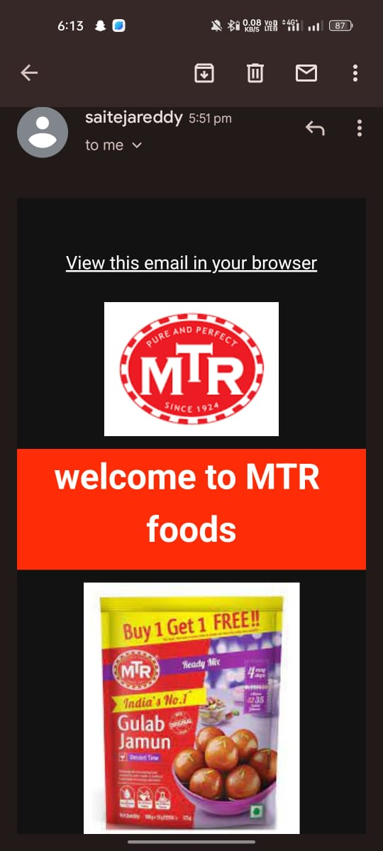
Email Ad Campaign 1 - Brand Awareness
(insert emailer image)

Slide 33
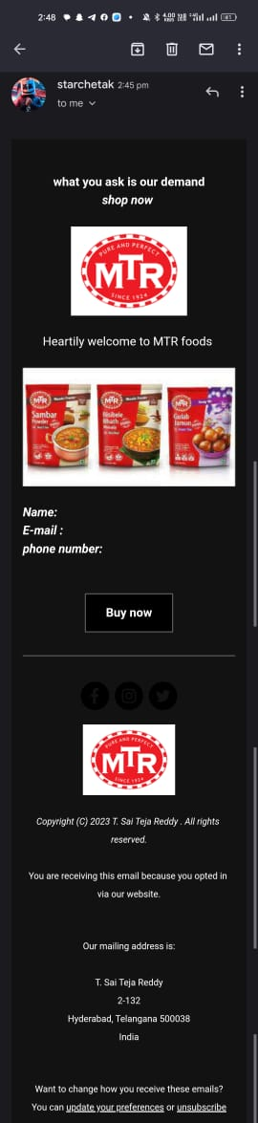
Email Ad Campaign 2 - Lead Generation
(insert emailer image)

Slide 34
Part 4: Content Creation and Curation (Post creations, Designs/Video Editing, Ad Campaigns over Social Media and Email Ideation and Creation)
Reflect on the content creation and curation process, discussing the challenges faced and lessons learned.
Consistency is Key: Maintaining a consistent tone, style, and frequency of content across platforms helps reinforce brand identity and improves audience recall.
2. Visual Appeal: Eye-catching visuals, well-designed graphics, and professionally edited videos can significantly enhance the impact of content and ad campaigns.
3. A/B Testing: Regularly conducting A/B + tests for ad campaigns and email subject lines allows for data-driven optimization and better results.
4.Know our Audience: Understanding the target audience's interests, pain points, and preferences is fundamental in creating relevant and engaging content.
5. Engage with the Audience: Responding to comments, messages, and feedback from the audience fosters a sense of community and builds trust.
6. Long-Term Approach: Content creation and marketing are not one-time endeavors.
A long-term, strategic approach is necessary to build brand awareness and achieve sustainable growth.
In conclusion, content creation and curation, along with thoughtful design, video editing, and well-executed ad campaigns, play a pivotal role in a successful marketing strategy. By understanding the challenges and incorporating the lessons learned, businesses can create compelling content that resonates with their target audience and drives results.

